Slide 1
Research Proposal: Deciphering the Philippines’ Volume of Net Sales Index (VoNSI) in Manufacturing:
Dynamics, Challenges, and Areas for Development
Jomari Manto College of Computer Studies & Engineering Jose Rizal University Mandaluyong City, Philippines jomari.manto@my.jru.edu
Blanzy Gwyneth Faith N. Cinco College of Computer Studies & Engineering Jose Rizal University Mandaluyong City blanzygwynnethfaith.cinco@my.jru.edu

Slide 2
Overview
The research examines the dynamics of the Philippine manufacturing sector, a key driver of macroeconomic performance.
Historical VoNSI data is analyzed to explore trends, challenges, and areas for development.
The study employs prescriptive and predictive analytics to:
Identify weak points in the sector
Provide data-driven recommendations
Ensure that well-performing industries sustain their momentum

Slide 3
Introduction
The manufacturing sector is a crucial driver of economic performance in developing countries.
It significantly contributes to Gross Domestic Product (GDP).
Some argue that manufacturing has lost its role as a growth engine.
However, Szirmai & Verspagen (2018) reaffirm its importance.
Challenges in the Philippine manufacturing sector:
Structural inefficiencies
Supply chain vulnerabilities
Fluctuating market demand

Slide 4
Problem Statement
The manufacturing sector contributed ₱3.78 trillion (17.6% of GDP) in 2023 but faces significant challenges.
Key challenges:
1. Shrinking Economic Share – GDP share has declined since the 1980s.
2. Low Foreign Investments – The Philippines attracted only $9.2B FDI in 2022, far behind Vietnam, Indonesia, and Singapore.
3. Skilled Labor Shortage – A lack of trained workers limits growth.
4. Weak Governance – Corruption and bureaucracy discourage investments.
5. Energy Crisis Risk – Rising electricity costs threaten operations.

Slide 5
Additional Challenges
Deluna (2013) - Trade Challenges:
6. Ineffective trade agreements (ASEAN, WTO)
7. High trade costs (logistics inefficiencies)
8. Underutilized export potential
9. Regulatory and customs delays
10. Export market imbalance (more imports than exports)
Tecson (1992) - Industrial Issues:
11. Outdated technology
12. Weak R&D investment
13. Market barriers for SMEs
14. Failed protection policies
15. Misaligned industrial policies

Slide 6
Research Questions
Key Performance Indicators: What measures best reflect the sector’s performance?
Historical Trends: Has the sector grown, declined, or fluctuated?
Sectoral Comparison: Which industries are thriving or struggling?
Economic & External Influences: How have policy shifts, global events, and crises impacted the sector?
Forecasting Potential: Can historical data predict future trends?

Slide 7
Research Objectives & Performance Indicators
Objectives:
Analyze long-term trends in the sector.
Identify top- and low-performing industries.
Compare industry growth patterns.
Explore future trends using forecasting models.
Performance Indicators:
Yearly Growth Rates – Assess industry improvement or decline.
Industry Rankings – Identify leading and lagging sectors.
Stability of Growth – Detect fluctuations.
Predictive Accuracy – Evaluate the reliability of forecasts.

Slide 8
Literature Review
Szirmai & Verspagen (2018): Manufacturing boosts productivity, job creation, and economic growth, especially in developing countries.
Deluna (2013): Found high trade costs, inefficiencies, and logistics issues hindering Philippine exports.
Tecson (1992): Identified low productivity, outdated technology, and weak policies as major issues.
Biemudo et al. (2022): Found poor infrastructure, weak supply chains, and low foreign investment limiting industrial expansion.

Slide 9
Data Sourcing and Processing
Key Data Sources:
Volume of Net Sales Index (VoNSI) – Measures manufacturing sales trends.
Annual Survey of Philippine Business and Industry (ASPBI) – Provides employment, revenue, and cost statistics.
Data Processing Tools:
R programming for data cleaning, visualization, and statistical modeling.

Slide 10
Methodologies
Descriptive Analytics:
Volume of Net Sales Index (VoNSI) – Measures manufacturing sales trends.
Exploratory Data Analysis (EDA) using visualization tools in R (ggplot2, dplyr).
Examining historical VoNSI and Growth Rate trends.
Predictive Analytics:
Time-series forecasting models (ARIMA, exponential smoothing) to predict future trends.
Visualization of forecasted manufacturing sector performance.

Slide 11
Ethical Considerations
Data Integrity: Using official sources (Philippine Statistics Authority).
Proper Attribution: Citing sources following IEEE standards.
Accurate Representation: Avoiding biased conclusions.
Responsible Forecasting: Highlighting model limitations.

Slide 12
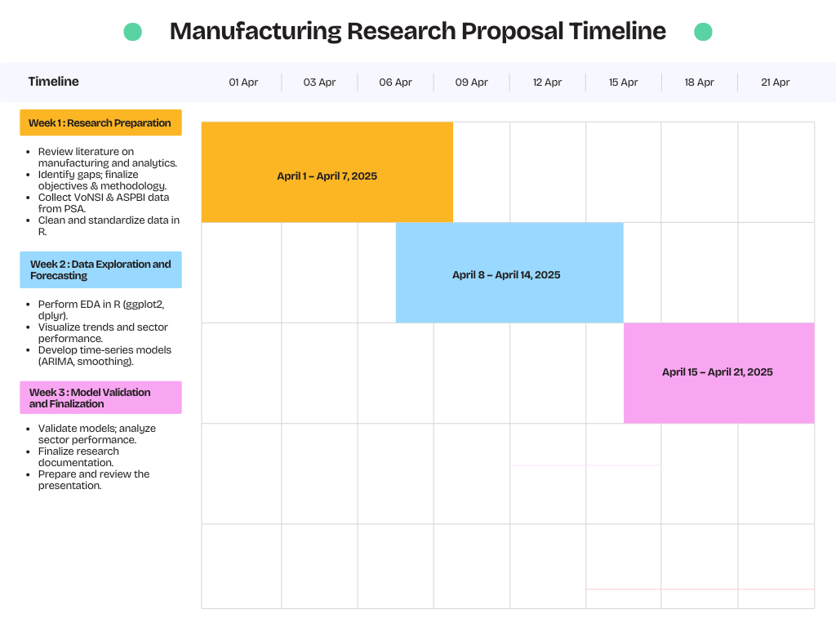

Slide 13
Conclusion
The study will analyze VoNSI data to provide insights into Philippine manufacturing performance.
Identifies challenges and suggests data-driven solutions.
Uses predictive analytics to forecast future trends.
Findings can assist policymakers, economists, and business leaders in strengthening the manufacturing sector.

Slide 14
References
A. Szirmai and B. Verspagen, "Manufacturing and Economic Growth in Developing Countries, 1950–2005," World Development, vol. 109, pp. 338–350, 2018, doi: 10.1016/j.worlddev.2018.05.005.
Statista Research Department, "Manufacturing sector in the Philippines - statistics & facts," Statista, Jan. 2025. [Online]. Available: https://www.statista.com/topics/11457/manufacturing-in-the-philippines/. [Accessed: 27-Mar-2025]
BusinessWorld, "Becoming a manufacturing powerhouse remains a pipe dream for Philippines," BusinessWorld Online, Jan. 3, 2024. [Online]. Available: https://www.bworldonline.com/top-stories/2024/01/03/566473/becoming-a-manufacturing-powerhouse-remains-a-pipe-dream-for-philippines/. [Accessed: Mar. 27, 2025]
R. S. Deluna Jr., "Trade Performance and Potential of the Philippines: An Application of Stochastic Frontier Gravity Model," Munich Personal RePEc Archive, Paper No. 51677, Apr. 30, 2013. Available: https://mpra.ub.uni-muenchen.de/51677/. [Accessed: 18-Mar-2025].
G. R. Tecson, Performance, Competitiveness, and Structure of Philippine Manufacturing Industries: A Research Design. Makati: Philippine Institute for Development Studies, 1992
K. G. Biemudo, R. V. Antonio, and N. A. J. Agustin, "An Empirical Analysis on the Impact of International Trade in Philippine Economic Growth," J. Econ. Finance Account. Stud., vol. 4, no. 1, pp. 607–628, 2022. [Online]. Available: https://www.al-kindipublisher.com/index.php/jefas. [Accessed: 18-Mar-2025].
Philippine Statistics Authority, "Volume of Net Sales Index (VoNSI) - Metadata," OpenSTAT, [Online]. Available: https://openstat.psa.gov.ph/Metadata/2G4CMSO0#:~:text=Volume%20of%20Net%20Sales%20Index%20(VoNSI)%20measures%20the%20change%20in,Price%20Index%20(PPI)%20deflator. [Accessed: 27-Mar-2025].

